Slide 1
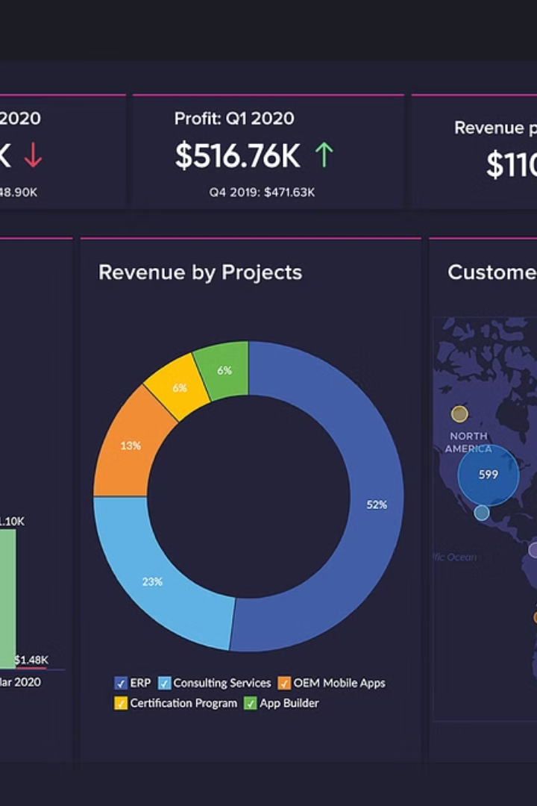
Customer Segmentation using Power BI
In this presentation, we'll explore the power of Power BI for customer segmentation, using real-world data and insightful visualizations.
Presented by,
Selshiya S
(TEAM 4)

Slide 2

Our Team Members,
Selshiya S
Ragini Katiyar
Abinaya
Mohamed Yasir
Vidhi Jain

Slide 3
Introduction to Power BI
What is Power BI?
Key Benefits
Power BI is a powerful business intelligence and data visualization tool from Microsoft. It allows users to connect to diverse data sources, transform and analyze data, and create interactive dashboards and reports.
Power BI empowers businesses to make data-driven decisions, gain insights from their data, and share actionable information with stakeholders. It's easy to use, flexible, and visually appealing, making it a popular choice for a wide range of business applications.

Slide 4
Dataset Overview
Data Source: Kaggle
Data Size: 19 columns, 3900 records
Key Attributes: customer demographics, purchase history, seasonal trend.

Slide 5
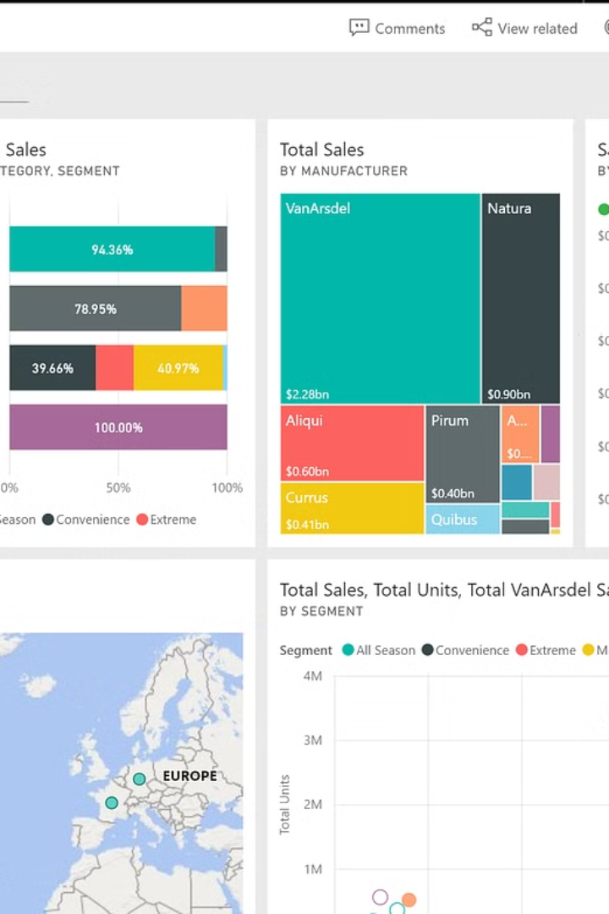
Overview of Performed Processes
1
Data Exploration
2
Data Modeling and Transformation
Power BI allows you to explore and understand your data. Connect to various data sources, including databases, spreadsheets, and cloud services.
Power BI empowers you to clean, shape, and transform your data using Power Query, ensuring data quality and consistency for insightful analysis.
3
Data Visualization and Reporting
4
Dashboard Creation and Collaboration
Create compelling and interactive visualizations, including charts, graphs, and maps. Use Power BI Desktop to design and share reports with stakeholders.
Build interactive dashboards that consolidate key metrics and provide a comprehensive view of your data. Collaborate with colleagues and share insights across your organization.

Slide 6




Key Concepts and Building Blocks
Data Sources
1
Databases, spreadsheets, cloud services, and more.
Data Transformation
2
Power Query, DAX Functions, and Data Cleaning.
Visualizations and Reports
3
Charts, graphs, and interactive dashboards.
Data Storytelling
4
Narratives, insights, and decision-making.

Slide 7
Data Preparation and Transformation
Data Cleaning
Data Transformation
DAX Functions
Remove duplicates, fill in missing values, and standardize data formats.
Shape and restructure your data using Power Query, including merging tables, grouping data, and applying calculations.
Create custom calculations and metrics using Data Analysis Expressions (DAX) within Power BI.

Slide 8
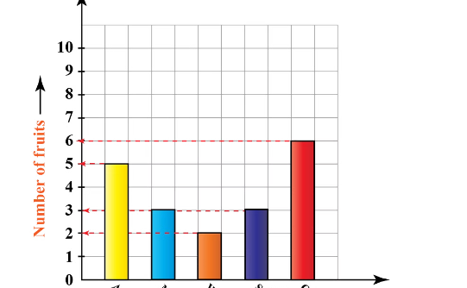
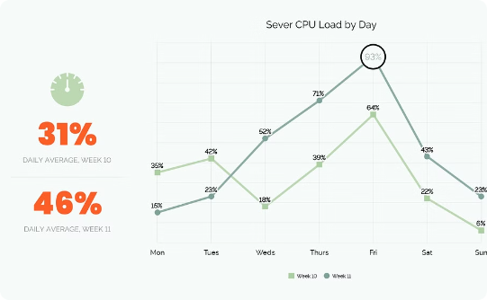
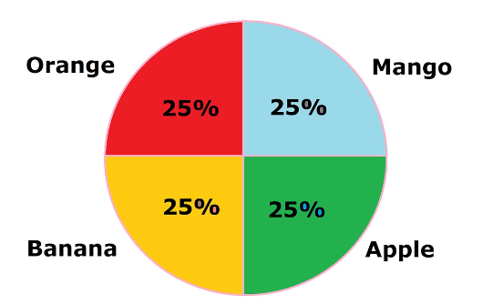
Creating Visualizations and Reports
Bar Charts
Line Charts
Pie Charts
Compare categories or groups of data.
Show trends and changes over time.
Represent proportions and parts of a whole.

Slide 9
Developing Interactive Dashboards
Develop Data Model
1
Define relationships between tables, create calculated columns and measures using DAX, and ensure the data model is optimized for analysis.
Design And Data Visualization
2
Add appropriate charts, tables, and slicers to represent data insights, and format them.
Enhance Interactive Elements
3
Add slicers, filters, and drill-down capabilities for exploration.
Review And Publish
4
Publish and share dashboards with stakeholders for collaboration.

Slide 10
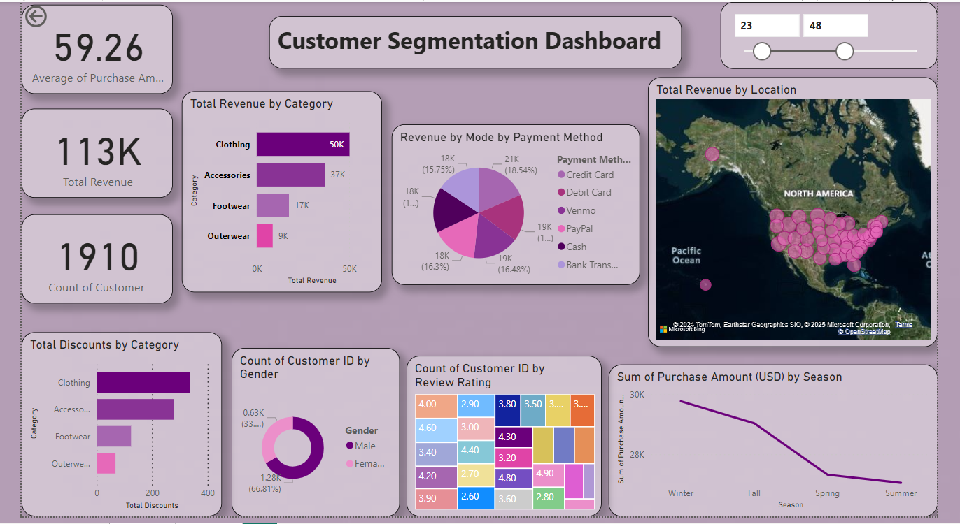
Dashboard(Page 1)

Slide 11
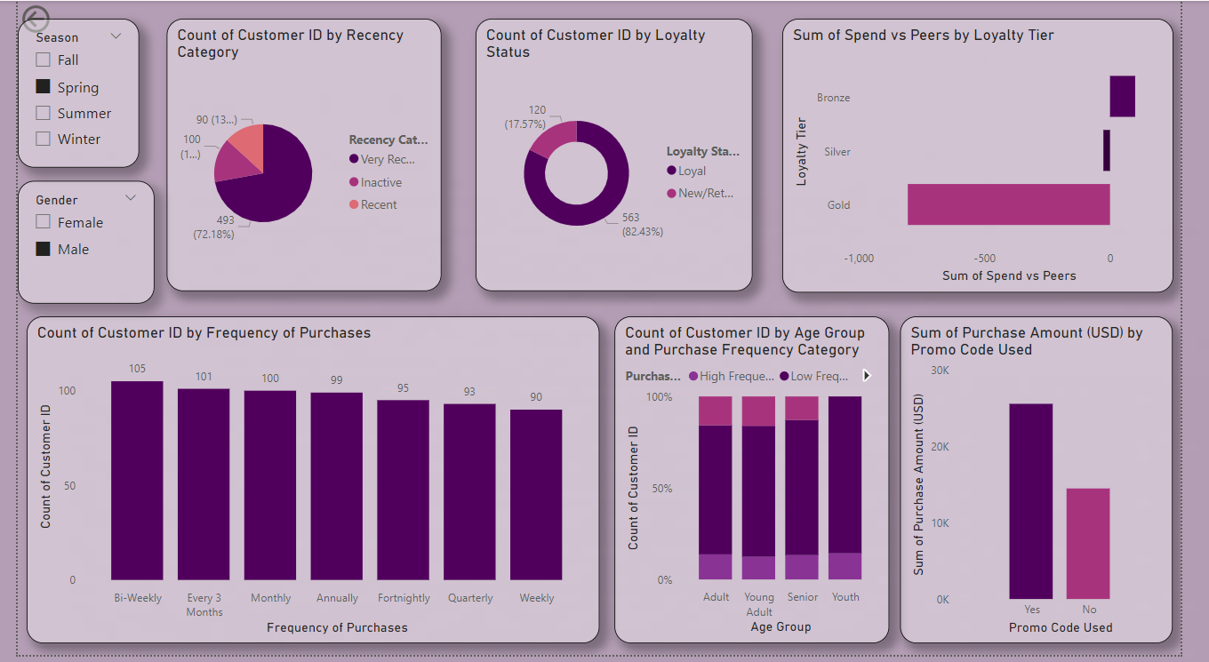
Page 2

Slide 12

Insights and Recommendations
1
2
Customer Segmentation
Seasonal Trends
Identify and analyze customer segments based on demographics, purchasing behavior, and other key metrics.
Detect spikes in sales during specific seasons or holidays, enabling better inventory planning and seasonal discounts.
3
4
Product Popularity
Customer Retention
Highlight top-selling products or categories, helping to focus on high-demand items and improve marketing strategies.
Identify high-value customers and develop strategies to retain them.

Slide 13
Thank You!

